Slide 1
Plant Monitoring Robot
Presented by:-
Ankita Panpatil
(F.Y MSc.IT)

Slide 2
Outline
What is a robot?
Asimov's Laws
Communication of Bolt Devices with Bolt Cloud
What is a plant monitoring robot?
Plant monitoring algorithm
Advantages
Disadvantages
Objective
Conclusion
Output

Slide 3

What is a robot?
A robot is an automatically guided machine capable of making decisions required to do a task, by monitoring, navigating through and manipulating its environment.
The word Robot is derived from a Czech word Robota’ which means ‘forced labor or a slave’.
The plant monitoring robot carries with it all the sensors required to monitor the environment, sampling the environment data at different pre-determined locations.
It then transmits this data via the Bolt WiFi module to the Bolt Cloud. With this robot you can monitor upto 6 different locations for, light/temperature or any other environment variable.

Slide 4

Asimov's Laws
Asimov’s Three Laws of Robotics:
A robot may not injure a human being or through inaction, allow a human being to come to harm.
A robot must obey the orders given to it by human beings except where such orders would conflict with the First Law.
A robot must protect its own existence as long as such protection does not conflict with the First or Second Law.

Slide 5
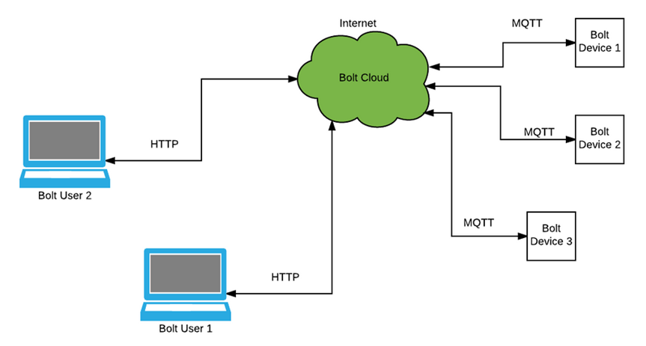
Communication of Bolt Devices with Bolt Cloud
The Bolt Cloud is one of the major component in providing the IoT capabilities to the Bolt device.
All the Bolt devices connect to the Bolt Cloud out of the box.
The Bolt devices are shipped with a firmware that helps it understand how to connect to the Bolt Cloud over the Internet.
Most IoT devices and sensors contain limited processing capabilities and constrained Internet bandwidth.

Slide 6

What is a plant monitoring robot?
Well the name plant monitoring robot is a bit of a misnomer.
While the name of the robot suggests that the robot monitors plants, what the robot will actually monitor is the environment in which a plant is placed.
we learned how logging the light intensity will help us understand how much light a plant is getting.
But with 1 Bolt WiFi module you can only monitor this data for one location, and hence we can only monitor the environment of 1 plant.

Slide 7

Plant monitoring algorithm
The plant monitoring algorithm is not very difficult to understand, but may sometimes be difficult to implement.
The robot's primary job is to move around the garden, collecting light intensity values.
While collecting data using the A0 pin of the Bolt WiFi module was pretty easy, we can't just use the same system here.
There is no way to tell the Bolt WiFi module when a certain location is reached.

Slide 8

Advantages
Using this project, you will be able to build a light monitoring system to collect the data and send it to the cloud.
The robots are not getting sick or tired, and the time off is not needed.
This project can then be extended to Predict the future sensor values via machine learning over the Bolt Cloud.
You may also send alerts over SMS and email using the features of Bolt Cloud Pro.

Slide 9

Disadvantages
It costs a lot of money to make or buy robots.
They need maintenance to keep them running.
The farmers can lose their jobs.
The robots can change the culture / the emotional appeal of agriculture.

Slide 10

Objective
Objectives of this project are to:
Build an energy saving Plant monitoring robot with integrated sensors and controllers
Design a Plant monitoring robot with modular approach design, which makes the system scalability and expandability.
Design a Plant monitoring robot which compatibility and scalability with other commercial product and automation system, which might include more than lighting systems.

Slide 11

Conclusion
This project is based on the principle that whenever the light falling on the sensor changes, the resistance of sensor changes which is then converted into a change in voltage.
The ADC pin on Bolt WiFi Module converted this analog voltage level into digital values which are shown on the graphs.
We connect the LDR between 5v pin and the analog input pin (A0), so that when light intensity increases, the resistance of LDR decreases so the voltage across the LDR decreases and as a result, the voltage on the analog input pin increases.

Slide 12
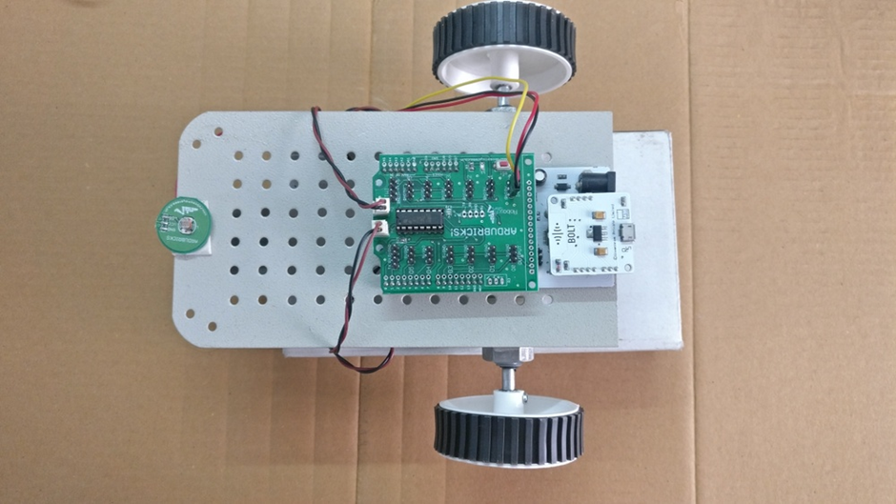
Output

Slide 13
Thank You!!!!!

